Slide 1

Spring Introduction MVC
Spring Fundamentals
SoftUni Team
Technical Trainers
Software University
https://softuni.bg

Slide 2
Table of Content
What is Spring MVC
Spring Controllers
Inversion of Control
Layers – dividing code
Thin Controllers

Slide 3
Questions
sli.do #java-web

Slide 4

What is Spring MVC?

Slide 5
What is Spring MVC?
Model-view-controller (MVC) framework is designed around a DispatcherServlet that dispatches requests to handlers
Find Controller
Handler
Mapping
Controller
Service
Request
Execute
Action
Dispatcher Servlet
Handler
Adapter
View Name
Repository
View
Resolver
Result Model
Resolve View
DB
Response
View
Result Model
Model
Business Logic
Notes:
Blue Color – Provided by Spring Purple Color – To Be Implemented by the Developer Green Color – Provided by Spring. Sometimes implemented by the developer

Slide 6
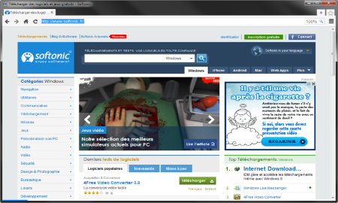



MVC – Control Flow
Web Client
Request
Controller
Response (html, json, xml)
Create Model
User Action
Update View
Model
View

Slide 7

Spring Controllers
Annotations, IoC Container

Slide 8
Spring Controllers
Defined with the @Controller annotation
Controllers can contain multiple actions on different routes
@Controller
public class HomeController {
...
}

Slide 9
Request Mapping (1)
Annotated with @RequestMapping(…)
Or
@RequestMapping("/home")
public String home(Model model) {
model.addAttribute("message", “Welcome!");
return "home-view";
}
@RequestMapping("/home")
public ModelAndView home(ModelAndView mav) {
mav.addObject("message", “Welcome!");
mav.setViewName("home-view");
return mav;
}

Slide 10
Request Mapping (2)
Problem when using @RequestMapping is that it accepts all types of request methods (get, post, put, delete, head, patch)
Execute only on GET requests
@RequestMapping(value="/home", method=RequestMethod.GET)
public String home() {
return "home-view";
}

Slide 11
Get Mapping
Easier way to create route for a GET request
This is alias for RequestMapping with method GET
@GetMapping("/home")
public String home() {
return "home-view";
}

Slide 12
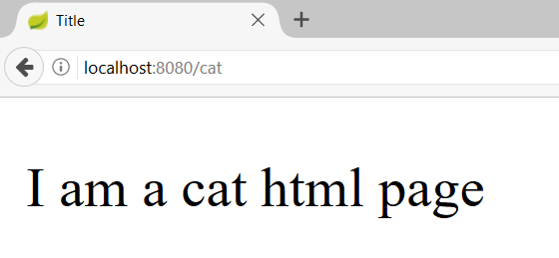
Actions – Get Requests
Controller
CatController.java
@Controller
public class CatController {
@GetMapping("/cat")
public String getHomeCatPage(){
return "cat-page.html";
}
}
Request Mapping
Action
View

Slide 13
Controllers
Controller
DogController.java
@Controller
public class DogController {
@GetMapping("/dog")
@ResponseBody
public Dog getDogHomePage(){
Dog dog = dogService.getBestDog();
return dog;
}
}
Request Mapping
Action

Slide 14
Post Mapping
Similar to the GetMapping there is also an alias for RequestMapping with method POST
Similar annotations exist for all other types of request methods
@PostMapping("/register")
public String register(UserDTO userDto) {
…
}

Slide 15
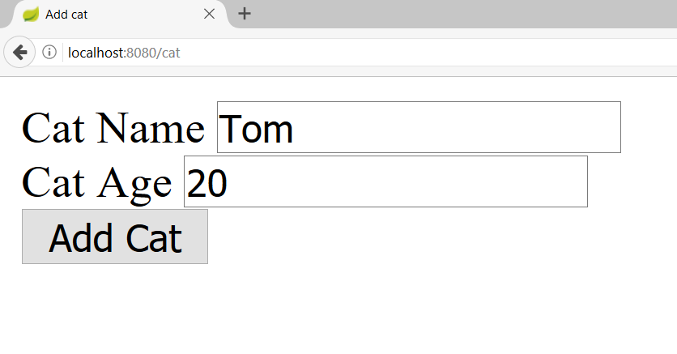
Actions – Post Requests (1)
CatController.java
@Controller
@RequestMapping("/cat")
public class CatController {
@GetMapping("")
public String addCat(){
return "new-cat.html";
}
}
Starting route

Slide 16

Actions – Post Requests (2)
CatController.java
@Controller
@RequestMapping("/cat")
public class CatController {
@PostMapping("")
public String addCatConfirm(@RequestParam String catName, @RequestParam int catAge){
System.out.println(String.format( "Cat Name: %s, Cat Age: %d", catName, catAge));
return "redirect:/cat";
}
}
Request param
Redirect

Slide 17
Passing Attributes to View (1)
Passing a String to the view
The Model object will be automatically passed to the view as context variables
Attributes can be accessed from Thymeleaf
@GetMapping("/")
public String welcome(Model model) {
model.addAttribute("name", "Pesho");
return "index";
}

Slide 18
Passing Attributes to View (2)
Passing a ModelMap object to the view
The ModelMap object will be automatically passed to the view as context variables
Attributes can be accessed from Thymeleaf
@GetMapping("/")
public String welcome(ModelMap modelMap) {
modelMap.addAttribute("name", "Pesho");
return "index";
}

Slide 19
Passing Attributes to View (3)
Passing a ModelAndView object to the view
The ModelAndView object will be automatically passed to the view as context variables
Attributes can be accessed from Thymeleaf
@GetMapping("/")
public ModelAndView welcome(ModelAndView model) {
model.addObject("name", "Pesho");
model.setViewName("index")
return model;
}

Slide 20
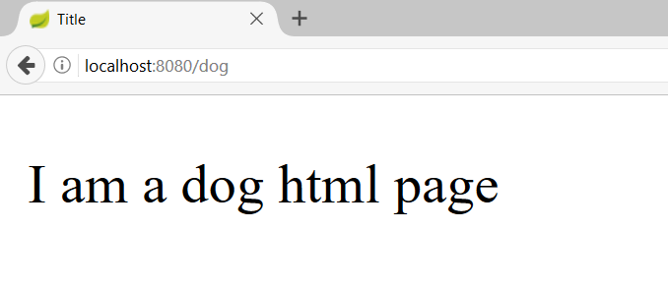
Models and Views
DogController.java
@Controller
public class DogController {
@GetMapping("/dog")
public ModelAndView getDogHomePage(ModelAndView modelAndView){
modelAndView.setViewName("dog-page.html");
return modelAndView;
}
}
Model and View

Slide 21
Request Parameters
Getting a parameter from the query string
@RequestParam can also be used to get POST parameters
@GetMapping("/details")
public String details(@RequestParam("id") Long id) {
...
}
@PostMapping("/register")
public String register(@RequestParam("name") String name) {
...
}

Slide 22
Request Parameters with Default Value
Getting a parameter from the query string
Making parameter optional
@GetMapping("/comment")
public String comment(@RequestParam(name="author", defaultValue = "Annonymous") String author) {
...
}
@GetMapping("/search")
public String search(@RequestParam(name="sort",
required = false) String sort) {
...
}

Slide 23
Path Variable
Getting a parameter from the query string
@GetMapping("/details/{id}")
public String details(@PathVariable("id") Long id) {
...
}

Slide 24
Form Objects
Spring will automatically try to fill objects with a form data
The input field names must be the same as the object field names
@PostMapping("/register")
public String register(UserDTO userDto) {
...
}

Slide 25
Redirecting
Redirecting after POST request
@PostMapping("/register")
public String register(UserDTO userDto) {
...
return "redirect:/login";
}

Slide 26
Redirecting with Parameters
Redirecting with query string parameters
@PostMapping("/register")
public String register(UserDTO userDto,
RedirectAttributes redirectAttributes) {
redirectAttributes.addAttribute("errorId", 3);
return "redirect:/login";
}

Slide 27
Redirecting with Attributes
Keeping objects after redirect
@PostMapping("/register")
public String register(@ModelAttribute UserDTO userDto,
RedirectAttributes redirectAttributes) {
...
redirectAttributes.addFlashAttribute("userDto", userDto);
return "redirect:/register";
}

Slide 28

Inversion of Control
Constructor vs Field vs Setter Injection

Slide 29

Field Injection
Easy to write
Easy to add new dependencies
It hides potential architectural problems!
@Autowired
private ServiceA serviceA
@Autowired
private ServiceB serviceB
@Autowired
private ServiceC serviceC

Slide 30

Constructor Injection
Time Consuming
Harder to add dependencies
It shows potential architectural problems!
@Autowired
public ControllerA(ServiceA serviceA, ServiceB serviceB, ServiceC serviceC) {
this.serviceA = serviceA;
this.serviceB = serviceB;
this.serviceC = serviceC;
}

Slide 31
Setter Injection
Create setters for dependencies
Can be combined easily with constructor injection
Flexibility in dependency resolution or object reconfiguration!
@Service
public class HomeContoller(){
//...
@Autowired
public void setServiceA(ServiceA serviceA) {
this.serviceA = serviceA;
}
}

Slide 32
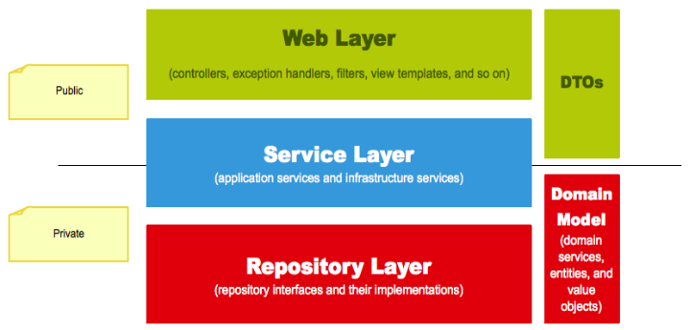
Layers
The Correct Project Structure

Slide 33
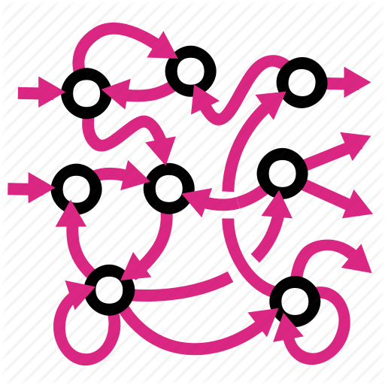
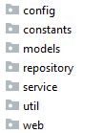

Layers (1)
We are used to splitting our code based on its functionality:
It gets hard to navigate in bigger applications

Slide 34


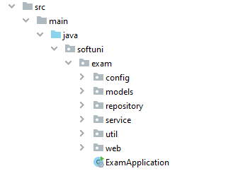
Layers (2)
Splitting the project into different modules
Each module corresponding to the application layer
Makes it easier to navigate

Slide 35

Thin Controllers
Creating Simple Components

Slide 36
Thin Controllers
Controllers should follow well known principles such as DRY and KISS
Should delegate functionality to the service layer
The service layer consists of application logic, e.g. services, executors, strategies, mappers, DTOs, entities, etc.

Slide 37

Live Demo

Slide 38

Summary
Spring MVC - MVC framework that has three main components:
Controller - controls the application flow
View - presentation layer
Model - data component with the main logic
Constructor injection – the best way for DI
Splitting your application code by layers
Every component should be as "thin" as possible
…
…
…

Slide 39
Questions?
Notes:
39

Slide 40














SoftUni Diamond Partners

Slide 41

Educational Partners

Slide 42
Trainings @ Software University (SoftUni)
Software University – High-Quality Education, Profession and Job for Software Developers
softuni.bg, about.softuni.bg
Software University Foundation
softuni.foundation
Software University @ Facebook
facebook.com/SoftwareUniversity
Software University Forums
forum.softuni.bg
Notes:
42

Slide 43

License
This course (slides, examples, demos, exercises, homework, documents, videos and other assets) is copyrighted content
Unauthorized copy, reproduction or use is illegal
© SoftUni – https://about.softuni.bg/
© Software University – https://softuni.bg
Notes:
43

